Slide 1

Chem 322
Selected Topic of Inorganic Chemistry
Dr. Md. Arzu Miah
Post Doc. ( KAIST, S. Korea), PhD (Veinna, Austria), M.Sc & B.Sc in Chemistry (JU)
Professor
Department of Chemistry
Jahangirnagar University
Savar, Dhaka-1342
Cell: 01732150725
mamiah@juniv.edu

Slide 2
Chapter -1
Bonding in Metals and Alloys

Slide 3
Chapter-1
Bonding in Metal And ALLOYS
What is Alloys?
What is Metallic Bonds
Properties of Metals
Theory of metallic bond formation
Difference between free electron theory and band theory of solids,
Bonding in metals and semiconductor Fermi level, Doping,
P-type and N-type semiconductor,
Depleting zone
Importance of metallic bond theory in understanding the basic principles of
Diode, LED and Solar cell.
Solid Solution
Imperfections in Solid

Slide 4
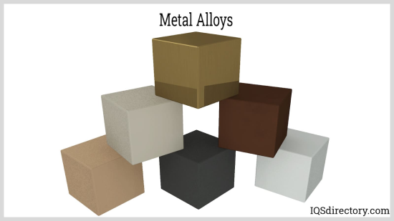
What is Alloys?
An alloy is a mixture of two or more elements, where at least one element is a metal. Many alloys are mixtures of two or more metals.
A substance composed of two or more metals or of a metal and a nonmetal intimately united usually by being fused together and dissolving in each other when molten.
Metal alloys emerge from the fusion of two or more elements to create a novel material.
Alloys of metals are often significantly stronger and harder than pure metals because of their tightly packed atoms

Slide 5
Comparing properties of alloys and pure metals
Steel | Elements | Properties
Mild steel | Carbon and iron | Easy to bend and pull into wires
Tool steel | Tungsten and iron | Hard, can be heated to high temperatures
Stainless steel | Chromium and iron | Hard, does not rust easily

Slide 6
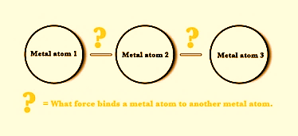
What is Metallic Bond?
A metallic bond is a force that binds several metal atoms
together in a metallic solid.

Slide 7
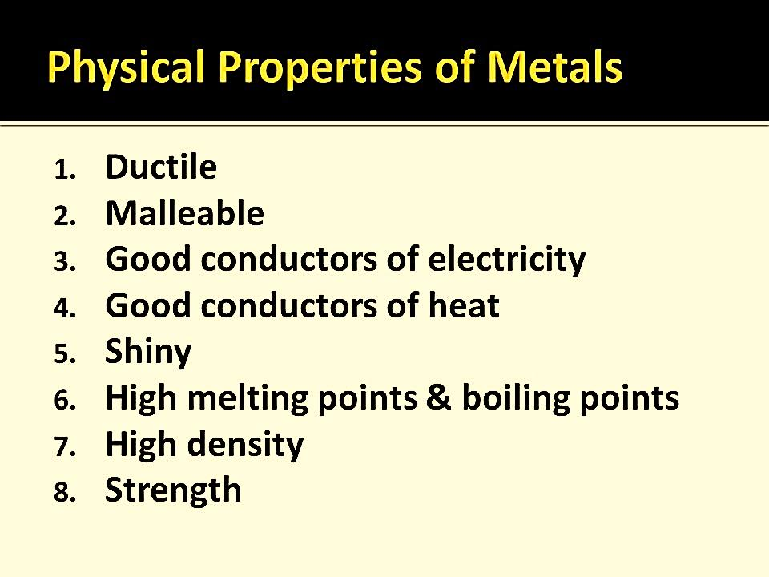

Slide 8
Theory
Electron Sea Model
Band Theory

Slide 9
1. What is the Electron Sea Model?
The Electron Sea Model suggests that:
Metal atoms lose their outer (valence) electrons, which become delocalized (not attached to any one atom).
These free-moving electrons form a “sea” of electrons that surrounds positively charged metal ions (cations).
This creates a strong electrostatic attraction between the negative electron sea and the positive metal ions.

Slide 10
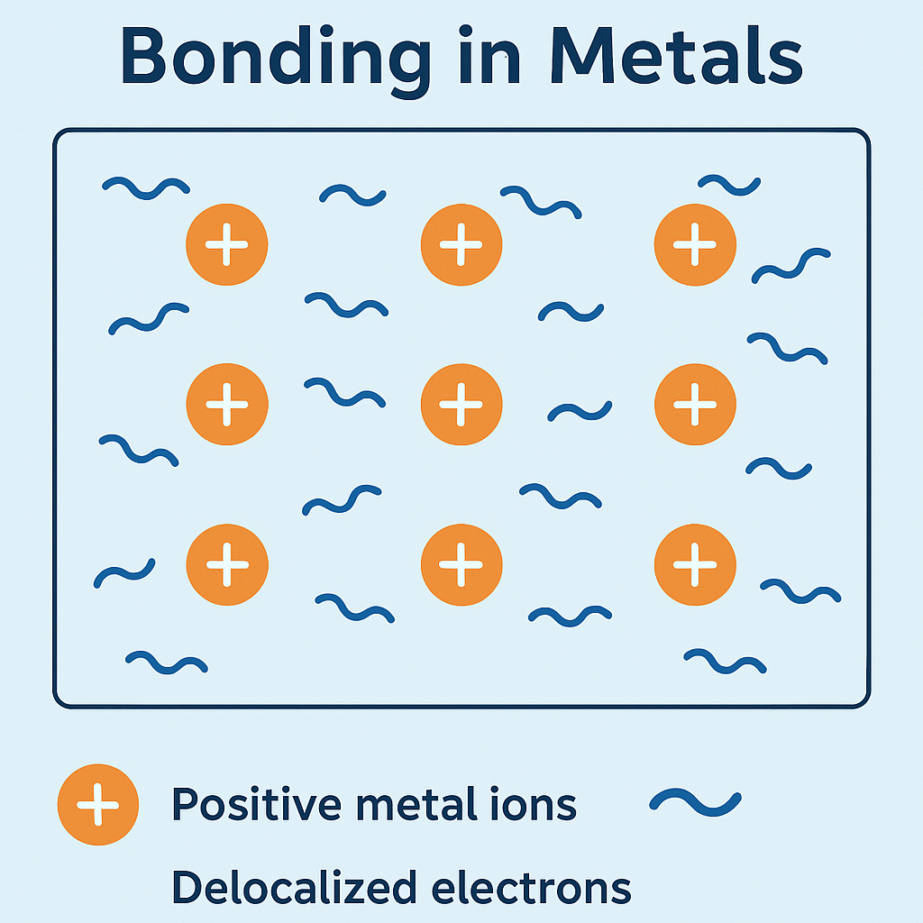

Slide 11
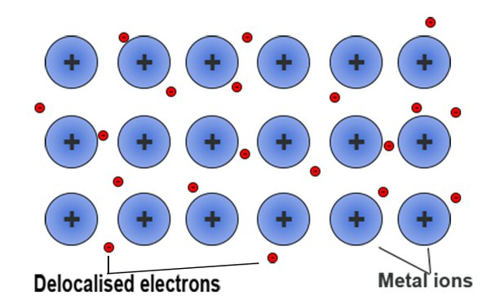

Slide 12
2. Structural Representation
• Metal ions arranged in a fixed lattice
• Free-moving electrons surround them
• Electrons act as a glue to bind the structure

Slide 13
3. Properties Explained by Electron Sea Model
• Electrical conductivity – Free electrons carry charge
• Thermal conductivity – Electrons transfer heat
• Luster – Electrons reflect light
• Malleability – Ions slide, bond remains
• High melting point – Strong electrostatic attraction

Slide 14
4. Example: Sodium (Na) Metal
• Each Na atom donates 1 valence electron
• Na⁺ ions form a lattice
• Electrons ensure conductivity and softness

Slide 15
5. Limitations of the Model
• Doesn’t explain all differences in metal properties
• Doesn’t consider quantum behavior
• Band theory provides more accuracy

Slide 16
6. Visual Summary (Concept Map)
Metal Atom → Loses Electron → Forms Positive Ion (Cation)
↓
Electron Sea → Delocalized Electrons Flow Freely
↓
Electrostatic Attraction between Cations and Electron Sea → Metallic Bond
↓
Results: Conductivity, Malleability, Ductility, High Melting Point

Slide 17
The discovery of metallic bonding started with certain observations. The observations indicated that the bond between two metal atoms is neither ionic nor covalent
OBSERVATION # 1 – Values of Electrical conductivity.
Electrical conductivity values show how well a substance allows electricity to pass through it.
Good conductors of electricity have greater electrical conductivity values.

Slide 18
This model stated that the metal atoms consist of two parts
The Atomic Core ⇒ includes the nucleus of the atom and all its inner shell electrons.
2) The Valence electrons ⇒ the outermost electrons of the atom.
This model considers the lattice as being made up of metal ions surrounded by a sea of delocalized electrons.

Slide 19
Limitation of Electron Sea Model
This Theory could not correctly predict the heat capacity and the temperature dependence of the electrical conductivity of metals.

Slide 20
The Band Theory Of Solids
Two AOs form two MOs –
i)one lower energy bonding molecular orbital(BMO) σ and
ii) another higher energy antibonding molecular orbital(ABMO), σ*.

Slide 21
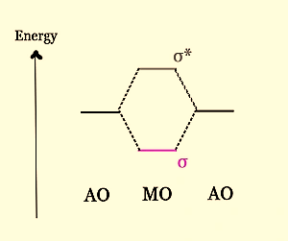
When this same approach is applied to an ensemble of atomic orbitals, we get very closely spaced BMOs and ABMOs, which appear like a band from a distance. The energy gap between them is very low, and so the levels appear to be in a continuum.
If N atomic orbitals combine to form N molecular orbitals, then N/2 will be bonding molecular orbitals and N/2 will be anti-bonding.

Slide 22
Two bands will be formed –
Bonding Molecular Orbitals Band → This is called the VALENCE BAND.
Anti-bonding Molecular Orbitals Band → This is called the CONDUCTION BAND.

Slide 23
What is Band Theory of Solids?
The way electrons behave inside a molecule is well explained through this theory.
In atoms, electrons are filled in respective energy orbits following Pauli’s exclusion principle.
In molecules, Two atomic orbitals combine together to form a molecular orbital with two distinct energy levels.
In solids, 10²³ stacked up lines confined in a tiny space would look like a band. Thereby forming energy continuum called energy bands.
This theory helps to visualize the difference between conductor, semiconductor and an insulator by plotting available energies for an electron in a material.

Slide 24
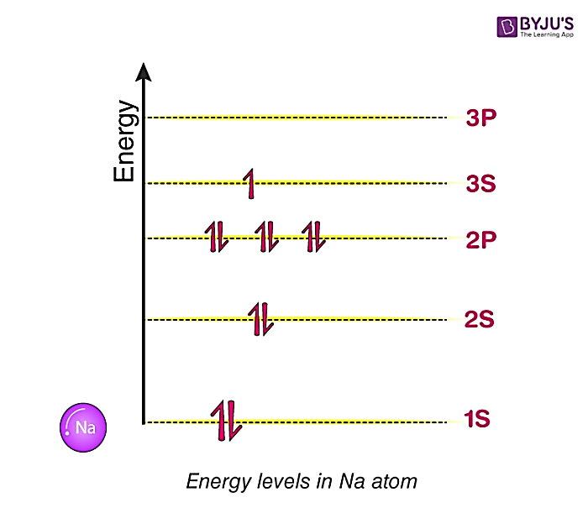
Energy Bands In Inside a Single atom
Consider a Sodium a atom. It comprises of 11 electrons. They fill up energy level following Pauli’s exclusion principle

Slide 25
Energy levels inside a molecule made up of two atoms
When two atoms come very close to each other.
Their respective energy bands are going to overlap on each other and transform into what we call as Molecular orbital.
Where the Lower energy level is called bonding orbital and Higher energy level is called anti-bonding orbital. This will repeat for all orbits.

Slide 26
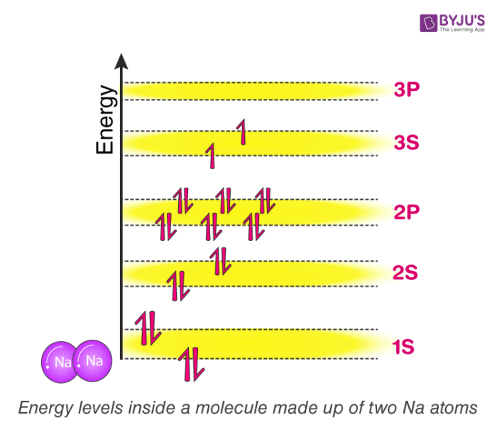

Slide 27
Energy levels inside a molecule made up of three atoms
Now try to picturise, what is going to happen if we add a third sodium atom to the mix?
The three atomic orbitals will be overlapping forming single molecular orbital with three discrete energy levels.
Each molecular orbital here will inherit three energy levels. In general, the more we add atoms, more energy levels the molecular orbit going to have.

Slide 28
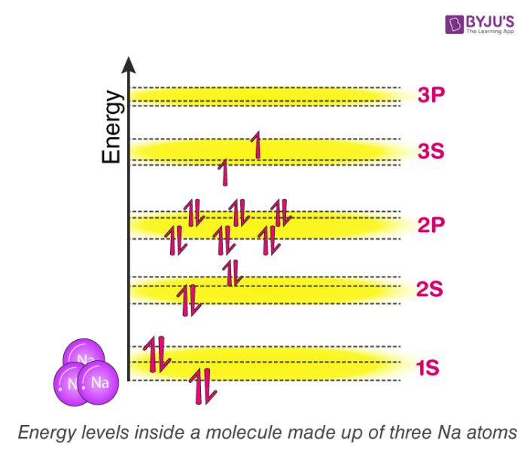


Slide 29
Energy levels inside a solid made up of Avogadro number of atoms
Eventually, if we have an entire solid, which is made of sodium with something like 10²³ atoms packed together, Each molecular orbital of this solid will have now 10²³ discrete energy levels.
For better understanding purpose, Think about drawing 1s orbital of Sodium solid block, draw lower energy level and upper energy level and in between stack it with 10²³ energy levels!
The gaps between them will be extremely small such that, no longer we can notice individual energy levels. As a result, It is convenient to think of it as continuous energy or energy continuum. When we think in this way, we can call them as energy band instead of molecular orbit.

Slide 30
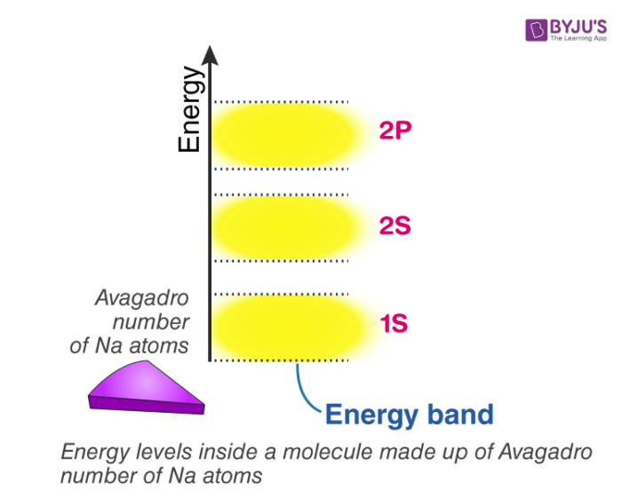

Slide 31
In general, If there are n-number of atoms, then there will be n discrete energy levels in each energy band.
In such a system of n number of atoms, the molecular orbitals are called as energy bands.
Single 1s orbital and 2s orbital can fit 2 electrons each. thus, the total number of electrons a 1s and 2s energy band can fit is 2n. A single 2p level can fit 6 electrons so 2p energy band can fit is 6n electron so on and so forth.
As atoms come close to each other and eventually form a solid, They end up forming energy continuum and we name that continuum as bands. Within the bands, energy levels which are available are continuous. Thus, the name of this theory without any surprise is, “The band theory of solids”
Using this theory, we can understand how free electrons are generated and why certain material readily have free electron available making them a conductor and why some others don’t?

Slide 32
Atoms have been seen to have discrete energy levels.
When a huge number of atoms are combined to form a solid however, these discrete energy levels are replaced by discrete ranges of energy, or energy bands, within which there are so many individual allowed energy values that within the bands the distribution can be considered to be continuous. This idea is seen in the following figure:

Slide 33
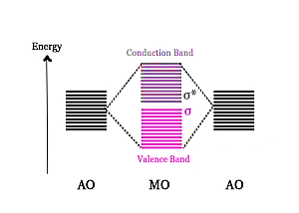
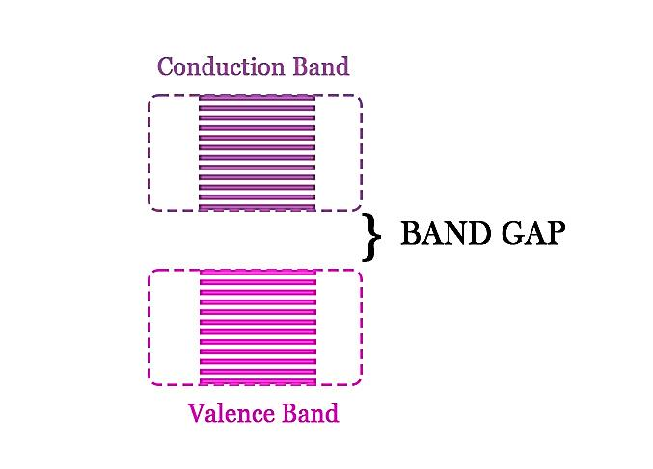
The energy gap between the valence and the conduction band is called BAND GAP/FORBIDDEN GAP/FORBIDDEN BAND.
This band gap determines whether a material is a Conductor, Semi-conductor, or An insulator

Slide 34
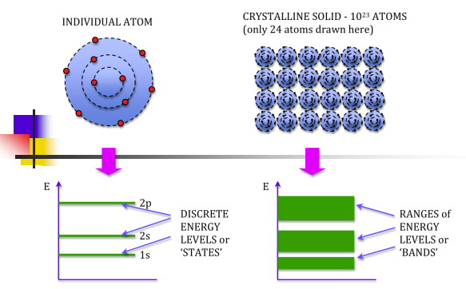

Slide 35
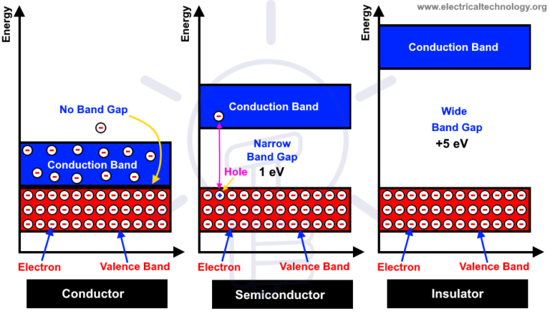
Classification of Metals Based on Band Theory
If the band gap is too high, the material is an insulator.
In semiconductors, this gap is a little less.
In metals, however, there is no band gap.
If there is only one electron in the valence shell of the atom, then the band will be half-filled

Slide 36
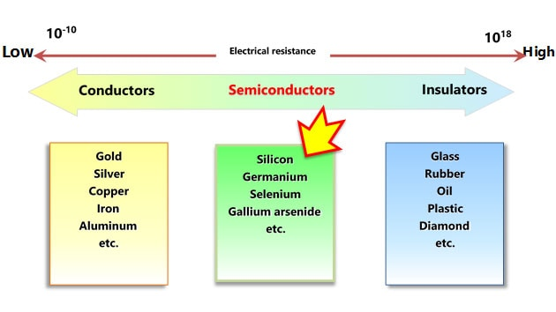

Slide 37
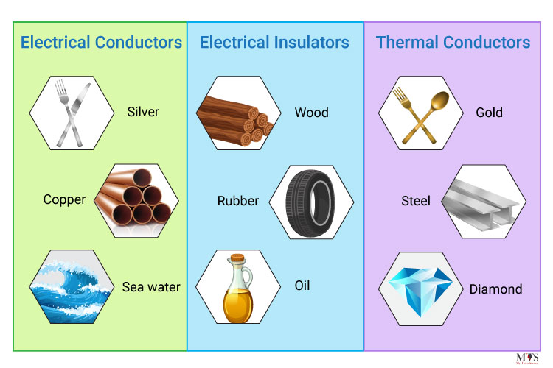

Slide 38
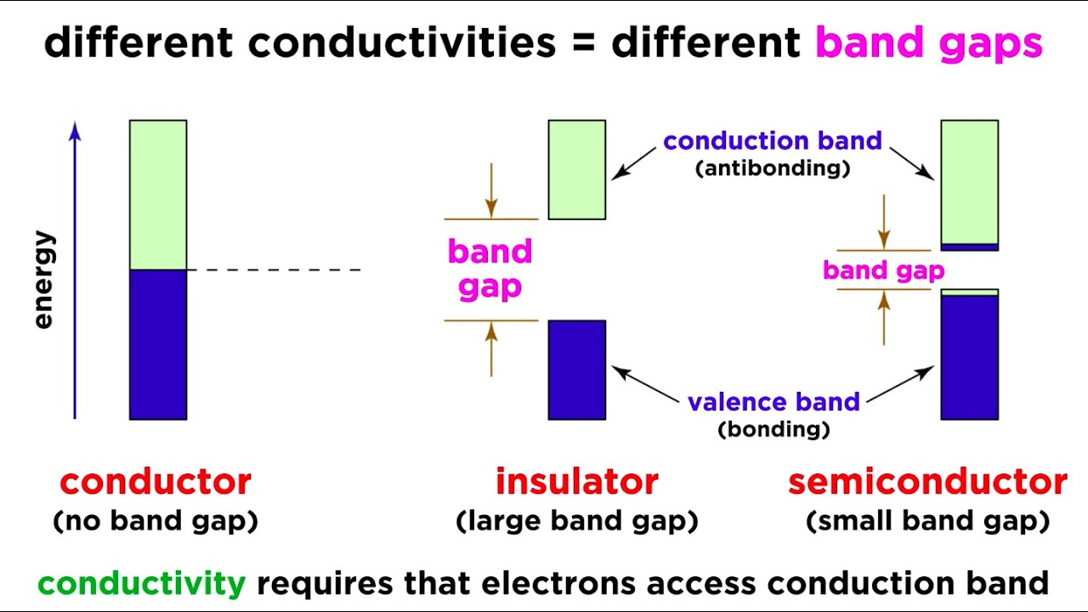

Slide 39
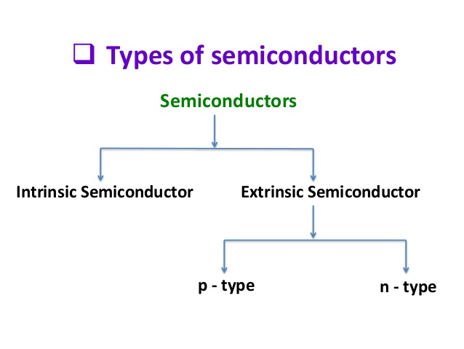

Slide 40
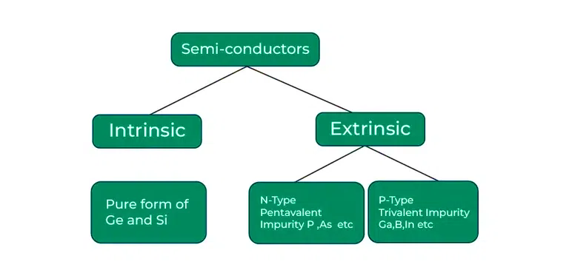

Slide 41
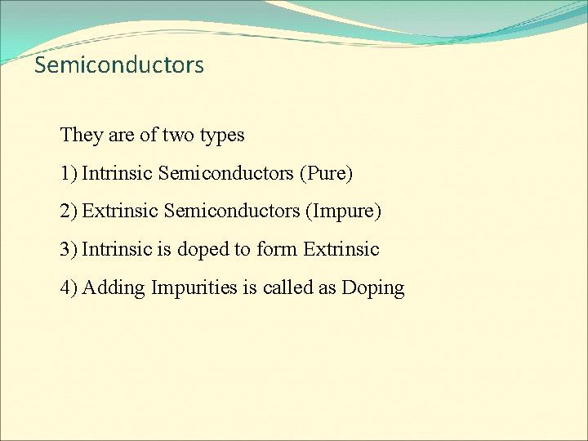

Slide 42
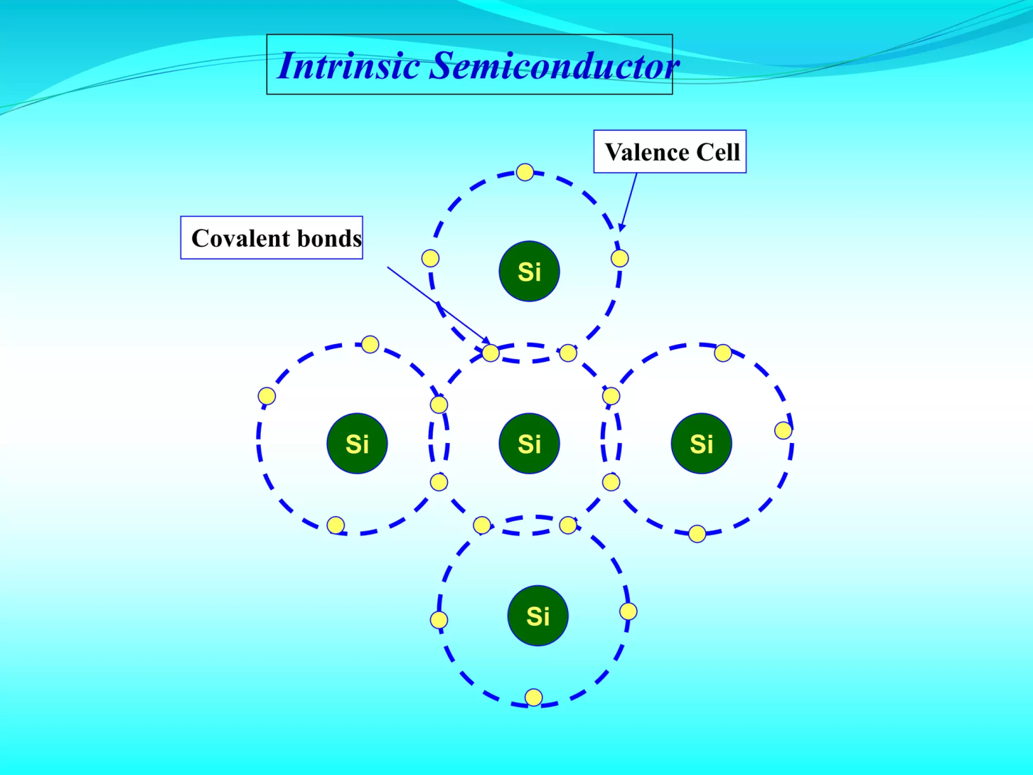

Slide 43
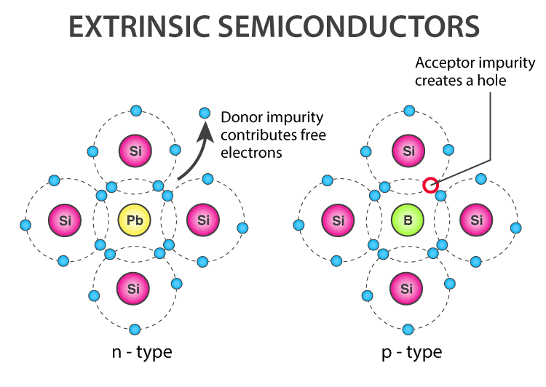

Slide 44
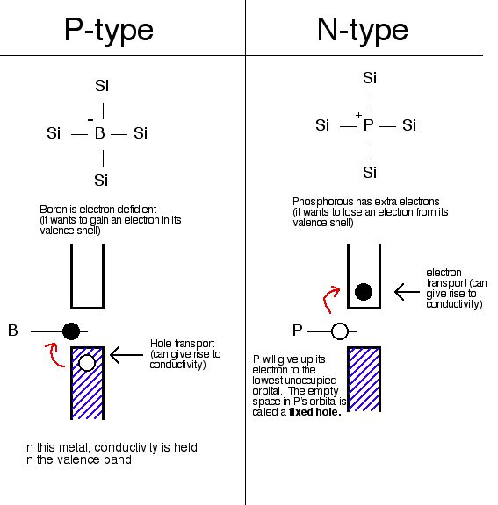
Extrinsic Semiconductors

Slide 45
Doping
Doping means the introduction of impurities into a semiconductor crystal to the defined modification of conductivity.
Two of the most important materials silicon can be doped with, are boron (3 valence electrons = 3-valent) and phosphorus (5 valence electrons = 5-valent). Other materials are aluminum, indium (3-valent) and arsenic, antimony (5-valent).
The dopant is integrated into the lattice structure of the semiconductor crystal, the number of outer electrons define the type of doping.
Elements with 3 valence electrons are used for p-type doping, 5-valued elements for n-doping. The conductivity of a deliberately contaminated silicon crystal can be increased by a factor of 10⁶.

Slide 46
n-doping
The 5-valent dopant has an outer electron more than the silicon atoms. Four outer electrons combine with ever one silicon atom, while the fifth electron is free to move and serves as charge carrier. This free electron requires much less energy to be lifted from the valence band into the conduction band, than the electrons which cause the intrinsic conductivity of silicon. The dopant, which emits an electron, is known as an electron donor (donare, lat. = to give).

Slide 47
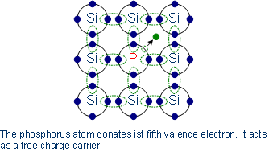
Doped semimetals whose conductivity is based on free (negative) electrons are n-type or n-doped.
n-doping with phosphorus
Arsenic is used as an alternative to phosphorus, because its diffusion coefficient is lower

Slide 48
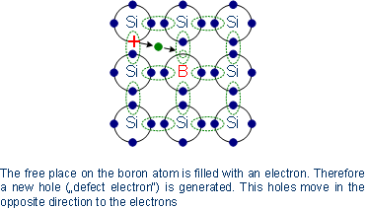
p-doping
The 3-valent dopants can catch an additional outer electron, thus leaving a hole in the valence band of silicon atoms. Therefore the electrons in the valence band become mobile. The holes move in the opposite direction to the movement of the electrons.
p-doping with boron

Slide 49
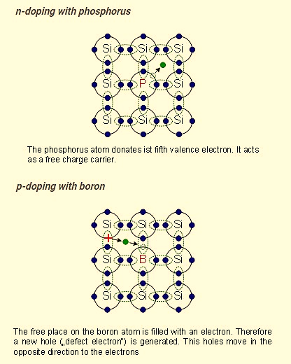

Slide 50
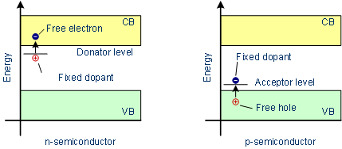
Electronic band structure in doped semiconductors
Band model of doped semiconductors

Slide 51
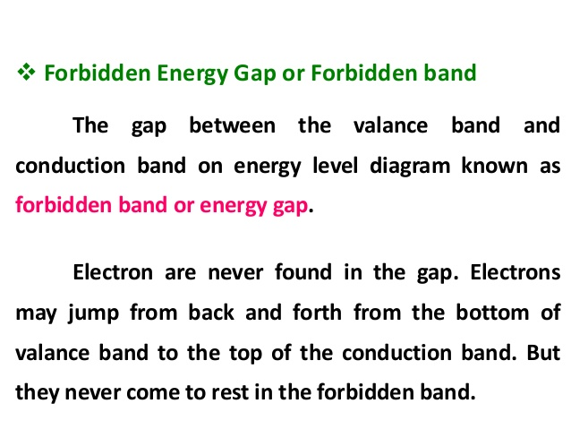

Slide 52
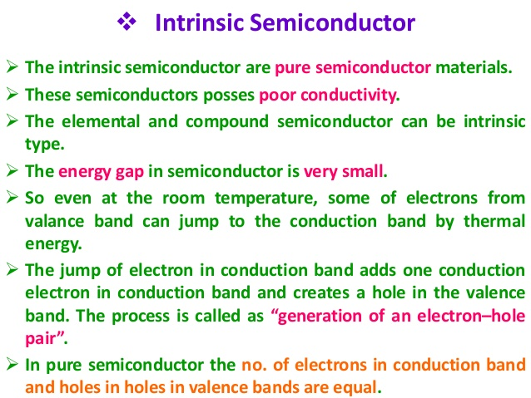

Slide 53
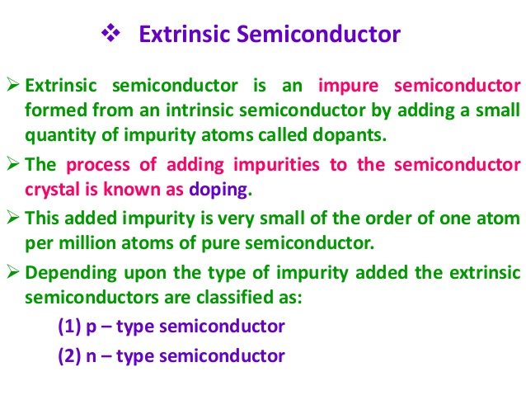

Slide 54
Difference between Intrinsic and Extrinsic Semiconductors
Intrinsic Semiconductor | Extrinsic Semiconductor
Pure semiconductor | Impure semiconductor
Density of electrons is equal to the density of holes | Density of electrons is not equal to the density of holes
Electrical conductivity is low | Electrical conductivity is high
Dependence on temperature only | Dependence on temperature as well as on the amount of impurity
No impurities | Trivalent impurity, pentavalent impurity

Slide 55
N-TYpe SeMICONDUCTOR
Conductivity is mainly because of electrons.
The material is entirely neutral.
The current (I) is due to electron current (Ie), and the concentration of electrons (ne) is much greater than that of holes (nh).
Majority carriers are electrons, and minority carriers are holes.

Slide 56
P-TYpe SeMICONDUCTOR
Conductivity is mainly because of the holes.
The material is entirely neutral.
The current (I) is due to hole current (Ih), and the concentration of holes (nh) is much greater than that of electrons (ne).
Majority carriers are holes, and minority carriers are electrons.

Slide 57
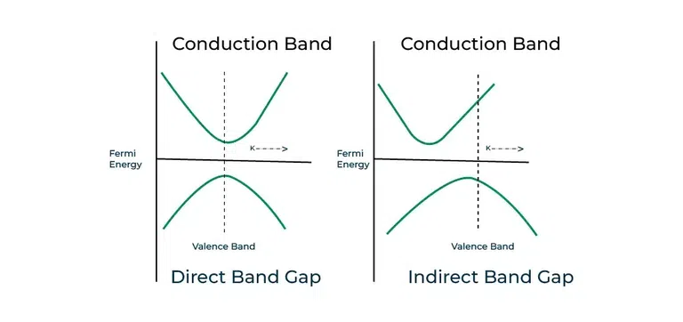
the top of valence band and the bottom of conduction band don’t have same momentum. Examples: Silicon (Si), Germanium (Ge) etc.
top of valence band and the bottom of the conduction band are at same momentum.
Examples: Gallium arsenide (GaAs), Indium phosphide (InP), Gallium nitride (GaN) etc.

Slide 58
Bringing the created N and P type Semiconductor together
The free electrons of negative N type region will move towards the P type semiconductor and the holes move in opposite direction towards n type region.
The holes and the electrons recombine with each other a form a region where no free mobile charge carriers(charge carriers which have movement ) are present it is known as depletion region.
In a forward bias, when a positive voltage is applied to the P-side and negative voltage to the N-side, the potential barrier is reduced, and current can flow across the junction.
In reverse bias, where the P-side is negative and the N-side is positive, the potential barrier increases, and the junction prevents significant current flow.

Slide 59
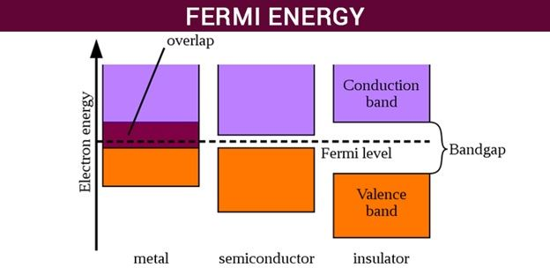
What is Fermi Level?
"Fermi level" is the term used to describe the top of the collection of electron energy levels at absolute zero temperature.

Slide 60
What is Fermi Energy?
Named after the Physicist, Enrico Fermi, a Fermi level is the measure of the energy of least tightly held electrons within a solid. It is important in determining the thermal and electrical properties of solids. It can be defined as:
The Fermi energy is a concept in quantum mechanics usually referring to the energy difference between the highest and lowest occupied single-particle states in a quantum system of non-interacting fermions at absolute zero temperature.
The value of the Fermi level at absolute zero temperature (−273.15 °C) is known as the Fermi energy.
It is also the maximum kinetic energy an electron can attain at 0K. Fermi energy is constant for each solid.

Slide 61
What is Quasi-fermi energy level?
Quasi-fermi energy level is defined as the change in the level of Fermi level as the charge carriers are added excessively to the semiconductor.

Slide 62
Applications of Fermi Energy
It is one of the important concepts in quantum mechanics and condensed matter physics. Some fermi energy applications are given in the points below.
It is used in semiconductors and insulators.
It is used to describe insulators, metals, and semiconductors.
Fermi energy is applied in determining the electrical and thermal characteristics of the solids.
It is also important in nuclear physics to understand the stability of white dwarfs. White dwarfs are stars that have a mass comparable to the Sun but have about a hundredth of its radius.

Slide 63
What is a Light Emitting Diode (LED)?
A Light Emitting Diode (LED) is a special type of PN junction diode. The light emitting diode is specially doped and made of a special type of semiconductor.
This diode can emit light when it is in the forward biased state. Aluminum indium gallium phosphide (AlInGaP) and indium gallium nitride (InGaN) are two of the most commonly used semiconductors for LED technologies.

Slide 64
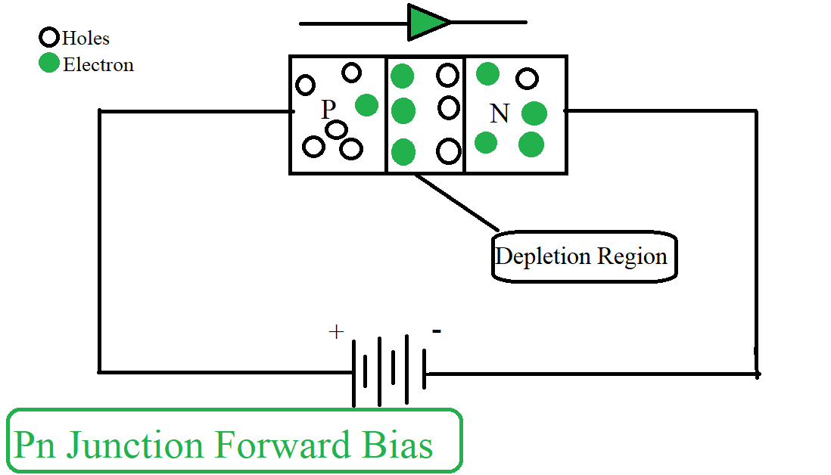
Formation of PN Junction by N and P type Semiconductor

Slide 65
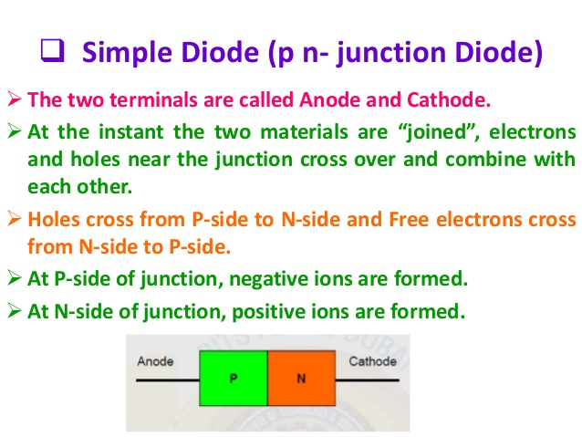

Slide 66
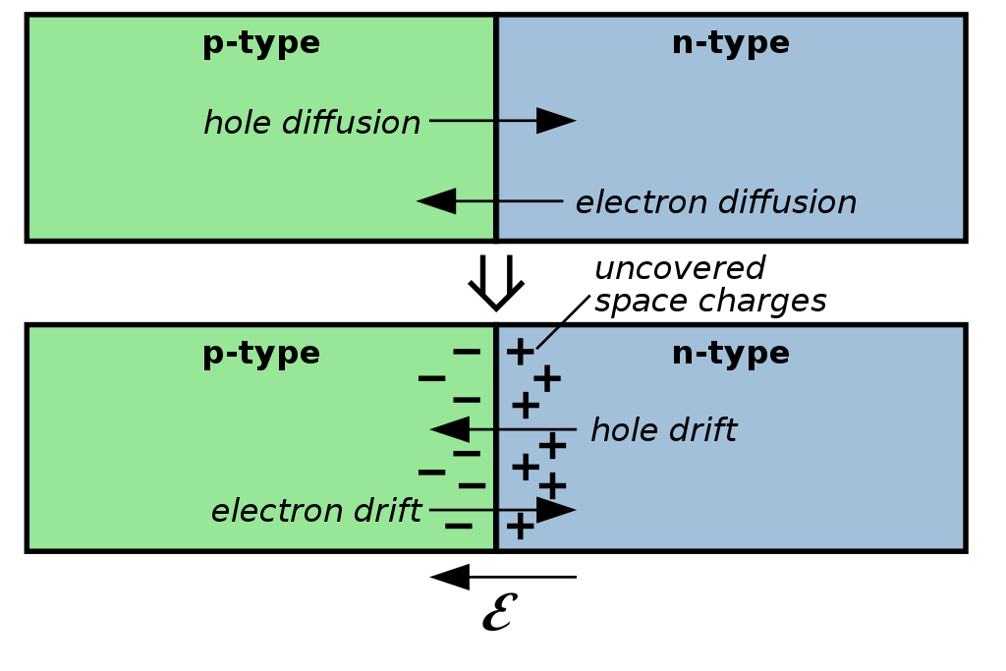
Top: p–n junction before diffusion; Bottom: After equilibrium is reached

Slide 67
Depletion region
Depletion region or depletion layer is a region in a P-N junction diode where no mobile charge carriers are present.
Depletion layer acts like a barrier that opposes the flow of electrons from n-side and holes from p-side

Slide 68
NP junction diode/pn junction diode
NP junction diode is a semiconductor device formed at the junction of an N-type and a P-type semiconductor material. It is also called pn junction diode.Its main features and functions:
Forward Bias: When a positive (+) voltage is applied to the P-side and a negative (-) voltage is applied to the N-side, the diode conducts, i.e. electricity flows.
Reverse Bias: When a negative (-) voltage is applied to the P-side and a positive (+) voltage is applied to the N-side, the diode is non-conducting, i.e. electricity does not flow.
Depletion Region: A barrier is formed at the junction of the N and P regions, which is called the depletion layer, which initially does not allow any charge carriers to flow.
Uses: Rectifier (to convert AC to DC)Voltage regulation To ensure unidirectional flow of electricity in a circuit

Slide 69
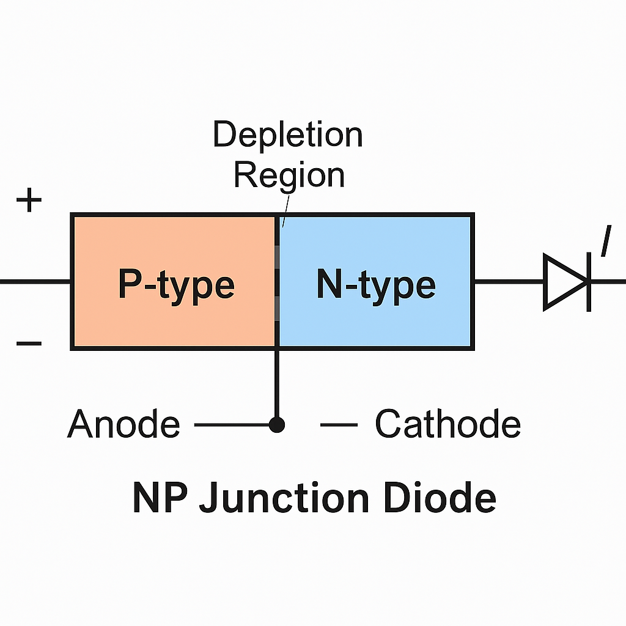

Slide 70
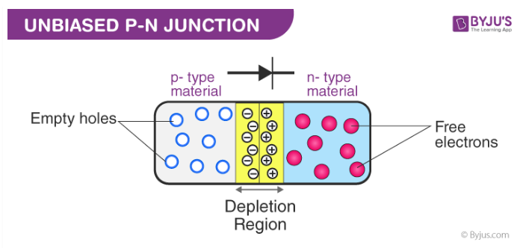

Slide 71
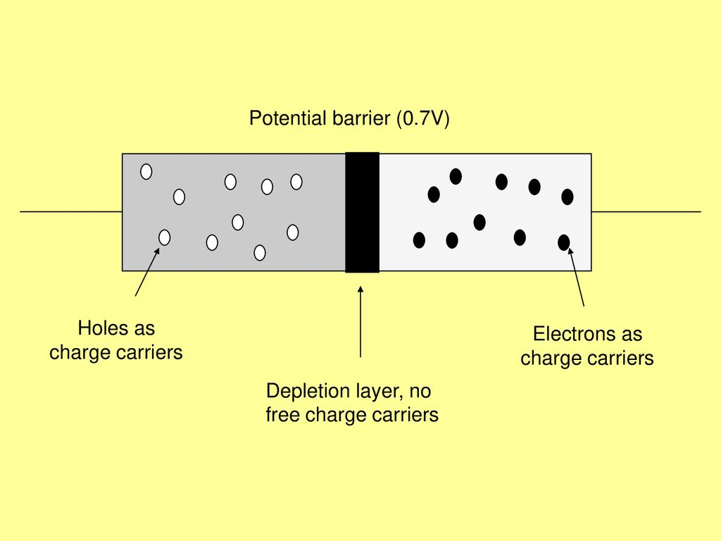

Slide 72
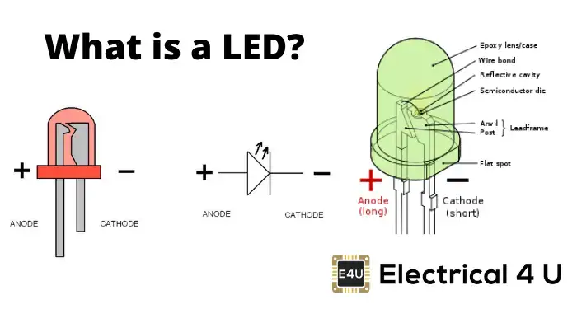

Slide 73
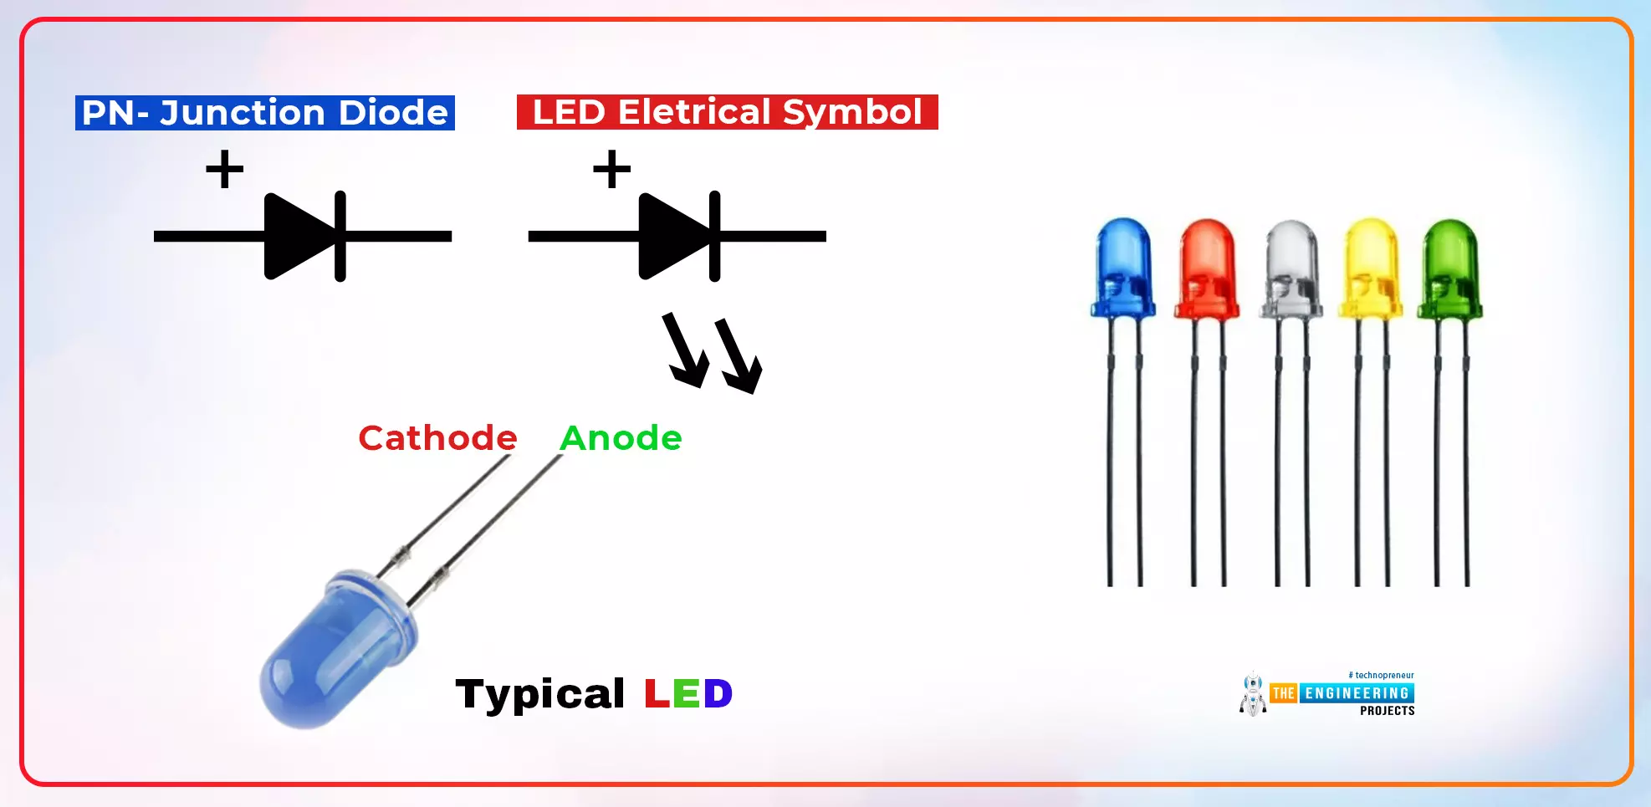
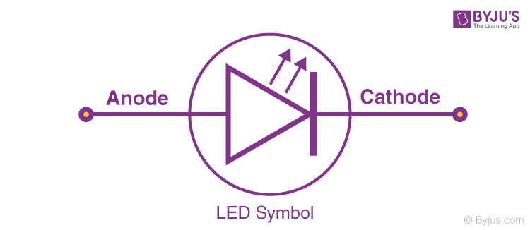

Slide 74
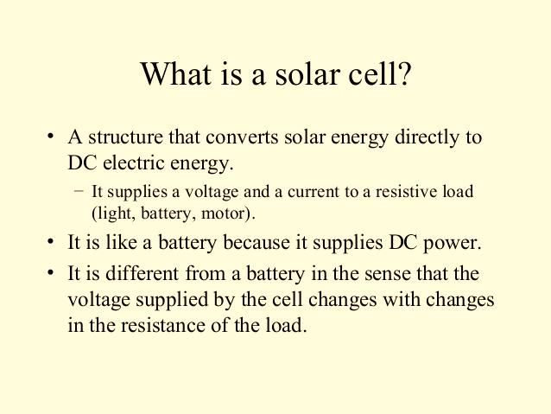

Slide 75
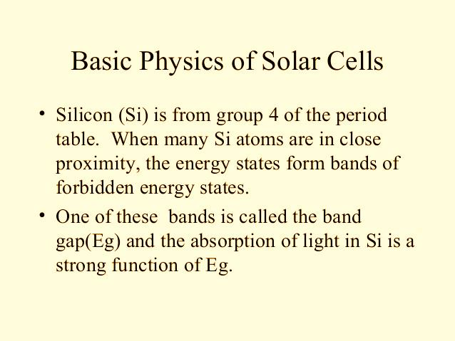

Slide 76
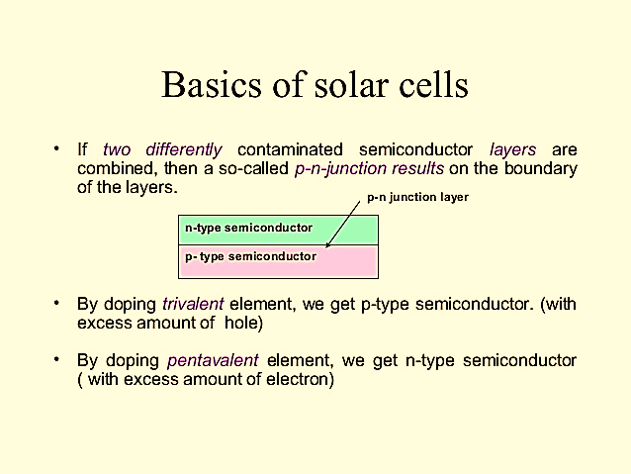

Slide 77
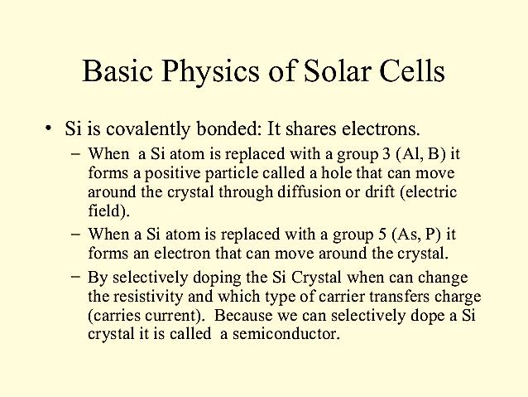

Slide 78
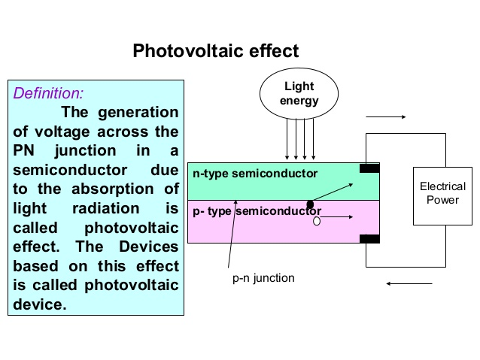

Slide 79
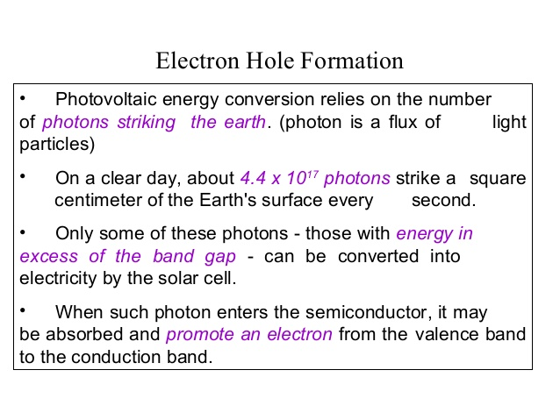

Slide 80
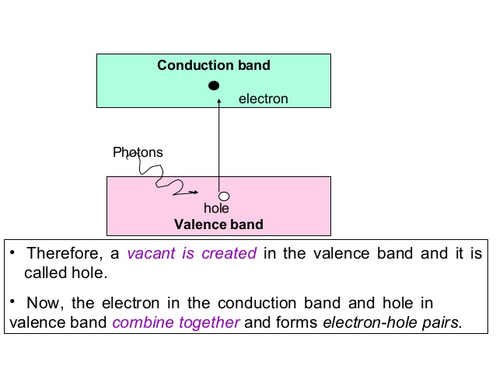

Slide 81
Solar CELL Mechanism
The mechanism of a solar cell, also known as the photovoltaic effect, involves the conversion of sunlight (solar energy) into electricity. Here's a breakdown of how a solar cell works:
1. Absorption of Light
Solar cells are made of semiconductor materials, typically silicon. When sunlight hits the solar cell, the photons (light particles) are absorbed by the semiconductor material.
This energy from the photons excites electrons in the material, giving them enough energy to break free from their atoms. This process is called photoexcitation.
2. Generation of Electron-Hole Pairs
As the photons hit the semiconductor, they knock electrons loose from their atoms. This creates electron-hole pairs. An electron is the negatively charged particle, and the hole is the absence of an electron, acting like a positively charged particle.
These electron-hole pairs are the key to generating electricity.

Slide 82
3. Creation of an Electric Field
Solar cells are designed with two layers of semiconductor material: one layer is positively charged (p-type) and the other is negatively charged (n-type). The p-n junction is formed where these two layers meet. This junction creates an electric field that pushes the free electrons in the n-type layer toward the p-type layer, and the holes toward the n-type layer. The electric field helps to separate the electrons and holes, preventing them from recombining.
4. Movement of Electrons
The electrons that are freed by the absorbed light are pushed through the electric field towards the n-type side.
These electrons are directed into an external circuit, creating an electric current.

Slide 83
5. Electric Current Generation
The movement of the electrons through the external circuit constitutes an electric current. This current can be used to power electrical devices.
The holes left behind in the p-type material move in the opposite direction, eventually reaching the external circuit, completing the electrical circuit.
6. Energy Output
The external circuit connects the positive and negative sides of the solar cell, allowing the electrons to flow, creating a direct current (DC).
This direct current can be used to power DC devices directly or converted to alternating current (AC) using an inverter for use in homes and businesses.

Slide 84
Summary of the Solar Cell Mechanism:
Photons from sunlight hit the semiconductor material.
Electrons are knocked free from their atoms, creating electron-hole pairs.
The electric field at the p-n junction drives the electrons toward the n-type material and holes toward the p-type material.
The movement of electrons creates an electric current.
The current is used to power electrical devices.
This process converts solar energy into usable electrical energy.

Slide 85
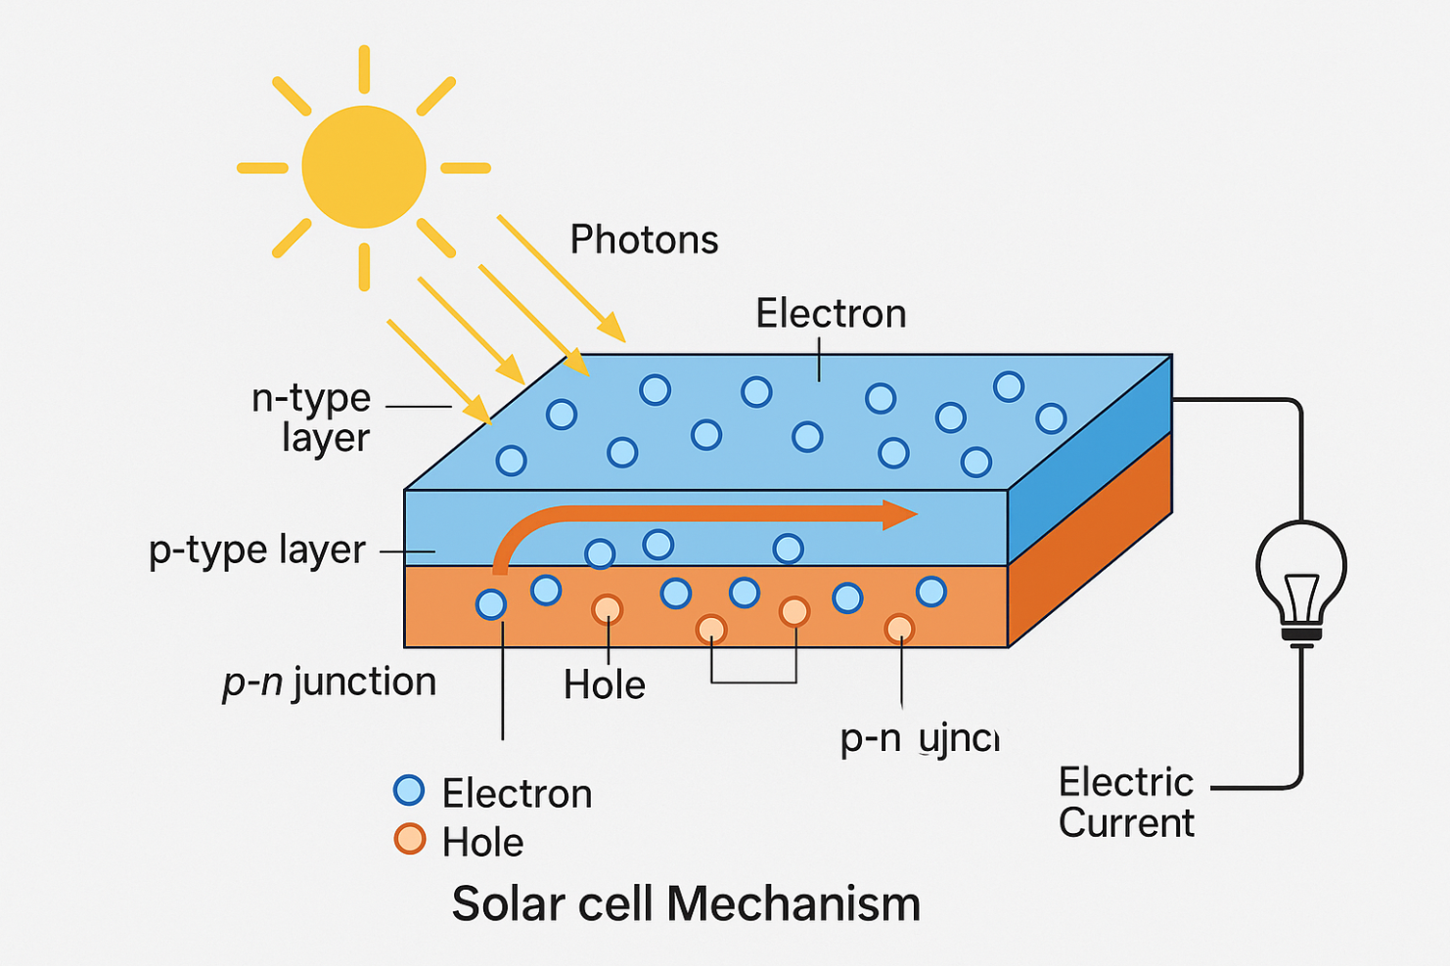
Solar CELL Mechanism

Slide 86
What causes the depletion region?
Solution:
A p-n junction diode's depletion area, also known as the depletion layer, is a space devoid of mobile charge carriers.
The depletion region is caused by the diffusion of charges. Because of the concentration gradient holes diffuse from p-side to the n-side across the junction while electrons diffuse from the n-side to the p-side.
The holes and the electrons diffusing towards each other combine near the junction.
When the diode is in the forward bias connection the width of the depletion region decreases.
When the diode is in the reverse bias connection the width of the depletion region increases.

Slide 87
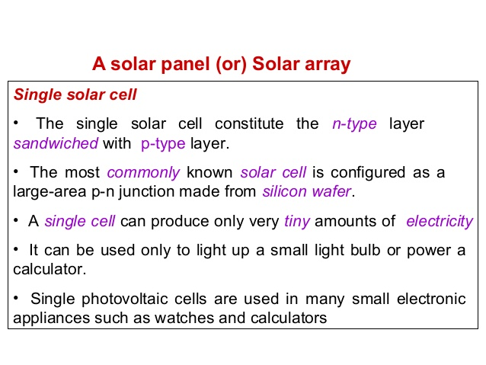

Slide 88


Slide 89


Slide 90


Slide 91


Slide 92


Slide 93


Slide 94

a comparison of solar cells in a table format

Slide 95


Slide 96


Slide 97


Slide 98


Slide 99
“Imperfection in solids"
The term "imperfection in solids" refers to deviations from the perfect, orderly arrangement of atoms or ions in a crystal lattice.
There are four main types of imperfections (also called defects) in solids:

Slide 100


Slide 101
1. Point Defects (Zero-dimensional)
These are imperfections that occur at or around a single lattice point.
Vacancy defect: A lattice site is vacant; an atom is missing.
Interstitial defect: An extra atom occupies a space between regular lattice points.
Substitutional defect: A different atom replaces an atom in the lattice.
Frenkel defect: An ion (usually cation) leaves its lattice site and occupies an interstitial site.
Schottky defect: Equal numbers of cations and anions are missing to maintain electrical neutrality.

Slide 102

Vacancy Defect
One atom is missing in the middle — that empty spot is the vacancy defect.

Slide 103

Interstitial Defect
Interstitial Atom is a Point Defect. Here a foreign atom occupies the interstitial position of a perfect crystal.
An extra atom is inserted into the lattice structure at a vacant position.

Slide 104

Self-Interstitial Atom is also a Point Defect. Here an extra atom of same crystal occupies the interstitial position of the crystal.

Slide 105

Substitutional defects
One atom is replaced by an atom of a different type.

Slide 106

Frenkel Defect
Example of Materials Where Frenkel Defect can be Found:
Zinc Sulfide (ZnS)
Silver Chloride (AgCl)
Silver Bromide (AgBr)
when one ion moves from its normal lattice site to an interstitial position

Slide 107

Schottky defect
Example of materials where Schottky defect can be found:
Sodium Chloride (NaCl)
Potassium Chloride (KCl)
Potassium Bromide (KBr)
Silver Bromide (AgBr)
Cerium Dioxide (CeO₂)
Thorium Dioxide (ThO₂)
cation and anion are lost from their normal lattice site

Slide 108

Differences between Schottky defect and Frenkel defect

Slide 109
2. Line Defects (One-dimensional
These are associated with a row of atoms and are commonly called dislocations.
Edge dislocation: An extra half-plane of atoms is inserted into a crystal.
Screw dislocation: A part of the crystal is shifted relative to the rest, creating a spiral structure.

Slide 110

Edge dislocations
Dislocations are generated if, for example, an extra half plane of atoms is inserted or removed. Such dislocations are called edge dislocations.

Slide 111

Screw dislocations
In screw dislocations, atoms are displaced in two separate planes perpendicular to each other.

Slide 112
3. Surface Defects (Two-dimensional)
These occur at the boundaries or surfaces of the material.
Grain boundaries: Found in polycrystalline materials where different crystals meet.
External surfaces: Atoms at the surface are not fully coordinated.
Stacking faults: A disruption in the regular stacking sequence of atomic planes.

Slide 113


Slide 114


Slide 115


Slide 116


Slide 117

4. Volume defects

Slide 118


Slide 119


Slide 120
Hume-Rothery Rules
The Hume-Rothery rules are:
Similar atomic radii (15% difference)
Similar electronegativities
Same crystal structure
Similar valency

Slide 121

In a solid solution, atoms from one element occupy sites in a crystal lattice (FCC, BCC, HCP, etc). This element is the solvent. Atoms from one or more elements are “dissolved” into the solvent.

Slide 122
Hume-Rothery Rules
The Hume-Rothery rules state that two elements will likely form a substitutional solid solution when these four conditions are met:
The atomic size of the solute atoms is within 15% of the atomic size of the solvent atoms.
The two elements have similar crystal structures.
The two elements have similar electronegativity.
The two elements have similar valences.

Slide 123
Solid solutions
Alloy- Alloy is a metal, composing of a mixture of elements. Most of alloys are composed of a base metal with small amounts of additives or alloying elements. The typical examples of alloys are steel/cast iron (iron base alloys), bronze/brass (copper base alloys), aluminum alloys, nickel base alloys, magnesium base alloys, titanium alloys.
A combination of metals is called an alloy.
There are 3 kinds of alloys:
Substitutional solid solutions
Interstitial solid solutions
Intermetallic compounds

Slide 124
Phase
Phase is a uniform part of an alloy, having a certain chemical composition and structure, and which is separated from other alloy constituents by a phase boundary.
Solid solution is a phase, where two or more elements are completely soluble in each other.

Slide 125
In a substitutional solid solution, the solute atoms will randomly take the place of the solvent atoms. This is a 1-to-1, direct substitution.
In an interstitial solid solution, the solute atoms fit between solvent atoms. We call these “in between” positions interstitial sites.
In an intermetallic compound, there is no solute or solvent. Instead the atoms bond stoichiometrically, just like any other compound. Because of this, most intermetallics do not behave like typical metals.

Slide 126


Slide 127
Metals crystal structure
There are two main forms of solid substance, characterizing different atoms arrangement in their microstructures:
Amorphous solid-Amorphous solid substance does not possess long-range order of atoms positions.
Crystalline solid : Crystalline solid substance is characterized by atoms arranged in a regular pattern, extending in all three dimensions.

